Slide 1
CIT 590
Intro to Programming

Slide 2
Logistics
  Friday office hours
  The deadline is May 5. Yes this is super lenient. Yes I am pretty crazy to do it.
  Big goal = every student of mine can say ‘yes I DID learn programming in CIT590’
  Enough time for even the laziest partner to contribute something to the project
  Do not advertise CIT 590 as the course where you get very liberal deadlines

Slide 3
Quiz next Monday
30-45 min in class programming assignment.
Open internet, open notes, open slides
Please do not solve and email to your friend in class
These WILL be checked for plagiarism
The question will not involve
  GUI
  Threads
  Making more than 3 classes
The question will involve unit testing (but of course!)

Slide 4
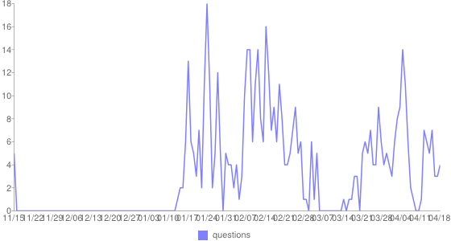
We crossed 500 posts. Thank you for using Piazza! Keep using it for studying for the exam.

Slide 5
HW10 thread craziness
You will have to make some kind of separate thread if you want things to be ‘animated’ after you click a button
Read the code in Test.java’s run method
Read the code we supplied in PieceMover.java
You will probably need at least one of those
If your piece only does teleportation and no animation, that is not the end of the world.
  Losing 2 points out of 30 in a grand total of 200 points cannot and will not affect your grade

Slide 6
HW 10 experiments
This is a great assignment for experimenting but here are suggested directions
Strategy – can we do something other than random
UI improvements (other than this teleportation craziness)
  Indicate potential places a piece can move to
Keep track of head to head scores of you versus your partner
  Some collection in memory
  Write down results in a file

Slide 7
Data structures and collections

Slide 8
Things you have already seen
Arrays
Arraylists
Vector
Main difference between ArrayList and Vector
  If you have a multithreaded program you want to use Vectors
  Access to Vectors is synchornized
  What this means is that only one thread can call methods on a Vector at a time

Slide 9
Static methods from Arrays
int[] array = {1,4,56,7, 5,6,11};
Arrays.sort(array);
System.out.println(Arrays.toString(array));
The Arrays class has many cool methods for manipulating an array.
Arrays.toList() – to go from the array world to the Collections world

Slide 10

Linked List in the abstract sense
Items being chained together. Does not have to be sorted in any way
Allows for very efficient insertion and removal. Dynamic (whenever more memory is needed it gets allocated)
Down side = random access of data is inefficient. You have to access sequentially.

Slide 11
Linked List in Java
It uses the <> syntax. <> = Generics.
It is actually a doubly linked list
  So internally you have connections to the next
  You also have connections to the previous
You could choose to ignore the warnings associated with generics ‘raw type etc etc’ but it will come back to hurt you later
Remove method
  Int
  Object
Which one will java use?

Slide 12
Experiments with linked lists
LinkedList<Integer> l = new LinkedList<Integer>();
l.add(3);
l.add(7);
l.add(4);
l.add(2);
How does remove work?
How does retain all work?

Slide 13
Stacks
Last in first out
Fundamental operations
  Push – push something into the stack and it goes to the top
  Pop – pop the topmost element out of the stack
Can a stack do something like get me the 3rd element from the top of the stack?
  Not unless it pops off two elements
Java’s stacks
  Stack<String> s = new Stack<String>();
  Note the usage of generics again

Slide 14
Queues
First in first out data structure
Line for tickets at the movies
If you try and make a Queue in java the same way that you make a Stack ….
  Fail ☹
No one can memorize all of these things …
Googling can be dangerous
Stack overflow can be even worse
Best answer = Java documentation

Slide 15
Java documentation
http://docs.oracle.com/javase/7/docs/api/
Java.util = collections
Java.io = files, scanners
If you know the class name you can just search for it directly

Slide 16
Linked data structures
Binary tree = at most 2 children.

Slide 17
Does java have a binary tree class we can use?
Not really …
So how do we actually create these data structures by ourselves?
What are the pieces of this binary tree anyway?
  One of the circular things (Generally called a node)
  The nodes are connected to other nodes!
The implementation I will show you does not involve generics (deliberately left out to not complicate matters)

Slide 18
Creating a Node class
public class Node {
int data;
Node left;
Node right;

Slide 19
Creating a binary tree class
What do I need to know in order to define my binary tree?

Slide 20
Methods for binary tree
Adding a node
  We will add the node in order to make it what is called a binary seach tree
Binary search tree = data to the left is less than the parent and data to the right is greater than the parent
For the sake of 0 headaches assume distinctness (or break ties by putting to the left)

Slide 21
Methods for binary tree
Traversal
Traditional traversal is done in ‘inorder’
left – parent – right
Naturally lends itself to recursion!

